Slide 1
Classes, Objects and Events
Santosh GSK
Industry Expert

Slide 2
Classes and Objects
Organization of objects into classes helps in knowledge representation
E.g., Person is a class, John is an object and instance of class Person
Interaction with the world takes place at the level of individual objects
Reasoning takes place at the level of Classes

Slide 3
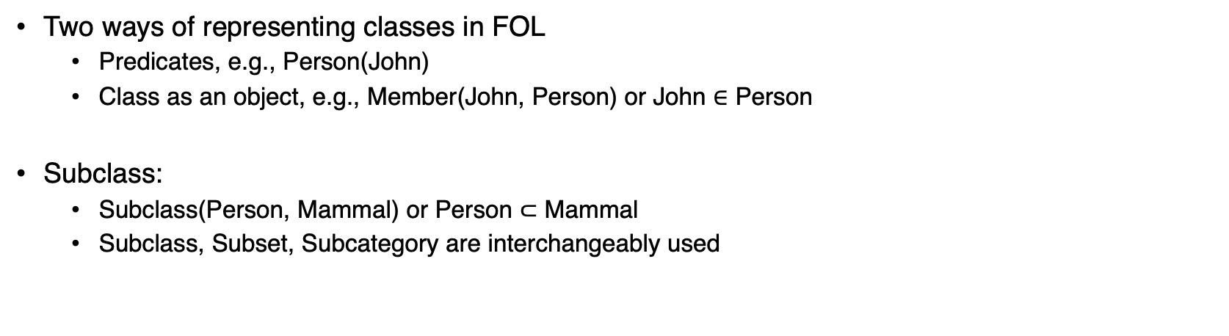
Class and Subclass
Two ways of representing classes in FOL
Predicates, e.g., Person(John)
Class as an object, e.g., Member(John, Person) or John $∈$ Person
Subclass:
Subclass(Person, Mammal) or Person $⊂$ Mammal
Subclass, Subset, Subcategory are interchangeably used

Slide 4
Inheritance
Classes serve to organize and simplify the knowledge base through inheritance
E.g., All instances of class Food are edible
Fruit is a subclass of Food
Apply is a subclass of Fruit
We can infer that, Apply is edible
Individual apples inherit the property edibility from their membership in Food class

Slide 5
Subclass
Subclass relations organize classes into a Taxonomy or Taxonomic hierarchy
Taxonomy is a branch of science dealing with classification of concepts, primarily organisms

Slide 6
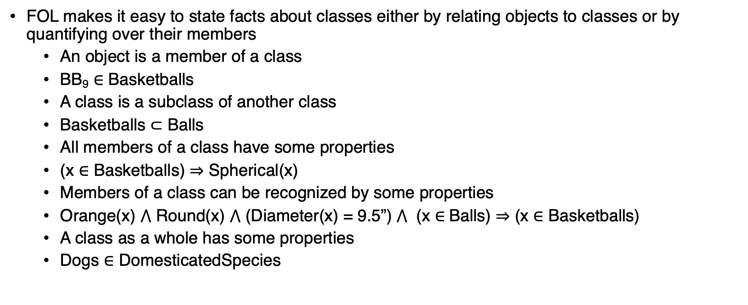
FOL and Classes
FOL makes it easy to state facts about classes either by relating objects to classes or by quantifying over their members
An object is a member of a class
BB₉ $∈$ Basketballs
A class is a subclass of another class
Basketballs $⊂$ Balls
All members of a class have some properties
(x $∈$ Basketballs) $⇒$ Spherical(x)
Members of a class can be recognized by some properties
Orange(x) $⋀$ Round(x) $⋀$ (Diameter(x) = 9.5”) $⋀$ (x $∈$Balls) $⇒$ (x $∈$ Basketballs)
A class as a whole has some properties
Dogs $∈$ DomesticatedSpecies

Slide 7
Relation between Classes
Apart from subclass – class relations, we can also have class – class relations
Disjoint Classes – Two or more classes are disjoint if they have no members in common
E.g., Male and Female are subclasses of Animals class and are disjoint classes
Exhaustive Decomposition – All possible constituent subclasses of a class
E.g., Jan, Feb, ..., Dec are subclasses of Months and are exhaustive decomposition
Partition – A disjoint and exhaustive decomposition subclasses are called a partition
E.g., Jan, Feb, …, Dec are a Partition of class Months
Disjoint({Animals, Vegetables})
ExhaustiveDecomposition({Americans, Canadians, Mexicans}, NorthAmericans)
Not a partition because few people might have dual citizenship
Partition({Jan, Feb, Mar, …, Dec}, Months)

Slide 8

Defining Classes
Classes can be defined by providing necessary and sufficient conditions for membership
Orange(x) $⋀$ Round(x) $⋀$ (Diameter(x) = 9.5”) $⋀$ (x $∈$Balls) $⇒$ (x $∈$ Basketballs)
x $∈$ Bachelors $⟺$ Unmarried(x) $⋀$ x $∈$Adults $⋀$ x $∈$ Males

Slide 9
Physical Composition
Idea: one object can be a part of another
E.g., One’s nose is part of one’s head; Hyderabad is part of India
Use PartOf relation to say that one is part of another
PartOf(Bucharest, Romania)
PartOf(Romania, EasternEurope)

Slide 10
Measurements
Objects have height, mass, cost and other properties that need to be measured
The values that we assign to these properties are called measures
Such properties are represented with a units function that takes number as a argument
For a line segment L₁, Length(L₁) = Inches(1.5) = Centimeters(3.81)
Conversion between units is done by equating multiples of one unit to another
Centimeters(2.54 x d) = Inches(d)

Slide 11
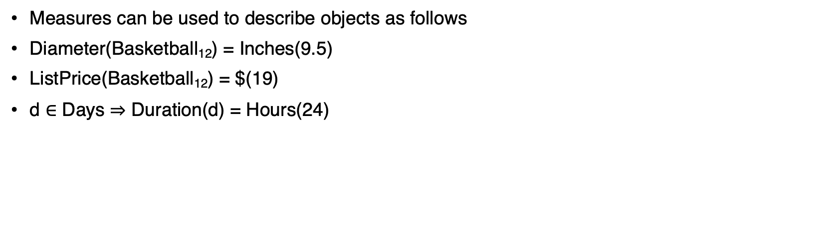
Measurements
Measures can be used to describe objects as follows
Diameter(Basketball₁₂) = Inches(9.5)
ListPrice(Basketball₁₂) = $(19)
d $∈$ Days $⇒$ Duration(d) = Hours(24)

Slide 12
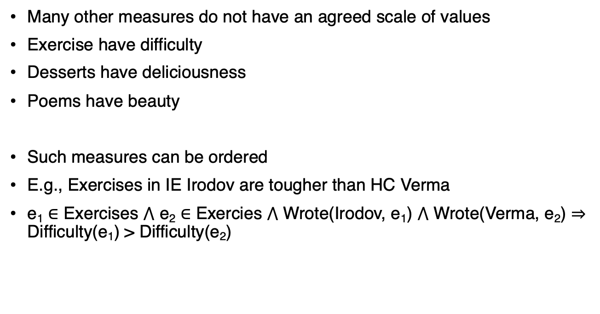
Ordered Measures
Many other measures do not have an agreed scale of values
Exercise have difficulty
Desserts have deliciousness
Poems have beauty
Such measures can be ordered
E.g., Exercises in IE Irodov are tougher than HC Verma
e₁ $∈$ Exercises $⋀$ e₂ $∈$ Exercies $⋀$ Wrote(Irodov, e₁) $⋀$ Wrote(Verma, e₂) $⇒$ Difficulty(e₁) > Difficulty(e₂)

Slide 13
Objects: Things and Stuff
There is a significant portion of reality that cannot be labeled as objects
We give it a generic name – stuff
Banana; Butter
Banana can be counted
Butter has no obvious number associated – there is no object called “butter” – even if you cut in half you would again get Butter
Mass nouns – butter, water
Count nouns – pen, banana

Slide 14
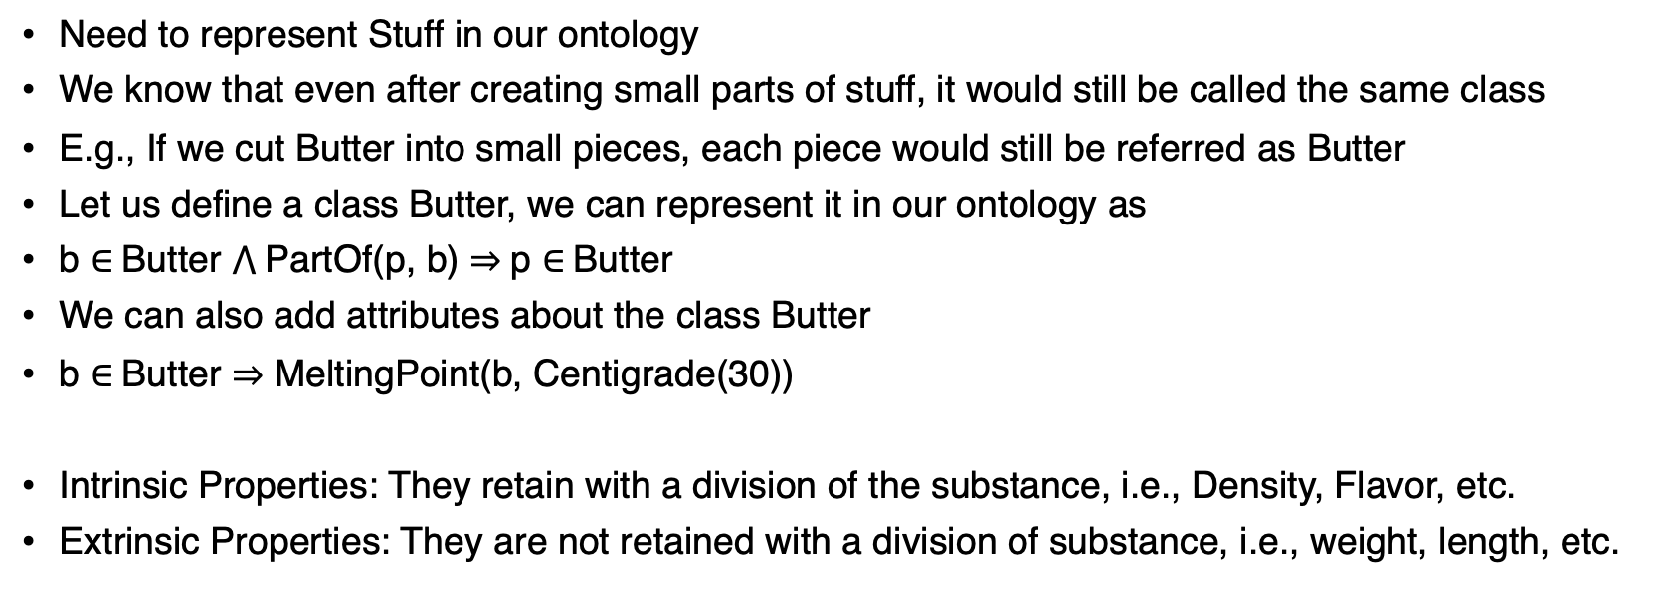
Representing Stuff
Need to represent Stuff in our ontology
We know that even after creating small parts of stuff, it would still be called the same class
E.g., If we cut Butter into small pieces, each piece would still be referred as Butter
Let us define a class Butter, we can represent it in our ontology as
b $∈$Butter $⋀$PartOf(p, b) $⇒$p $∈$Butter
We can also add attributes about the class Butter
b $∈$Butter $⇒$ MeltingPoint(b, Centigrade(30))
Intrinsic Properties: They retain with a division of the substance, i.e., Density, Flavor, etc.
Extrinsic Properties: They are not retained with a division of substance, i.e., weight, length, etc.

Slide 15
Events
So far the actions defined are discrete and instantaneous, e.g., moving from city A to city B
However, the continuous action of driving from city A to B is not defined
Consider the act of listening to a podcast while driving from city A to city B
Such cases cannot be handled with the existing formalism of actions
Event Calculus: Defined to handle such cases
It is based on points of time rather than on situations

Slide 16
Events
Event calculus defines fluents and events
A fluent At(Shankar, BITS) is an object that refers to the fact of Shankar being in BITS
Doesn’t say whether it is True
To assert that a fluent is true at some point, we use predicate T
T(At(Shankar, BITS), t)

Slide 17
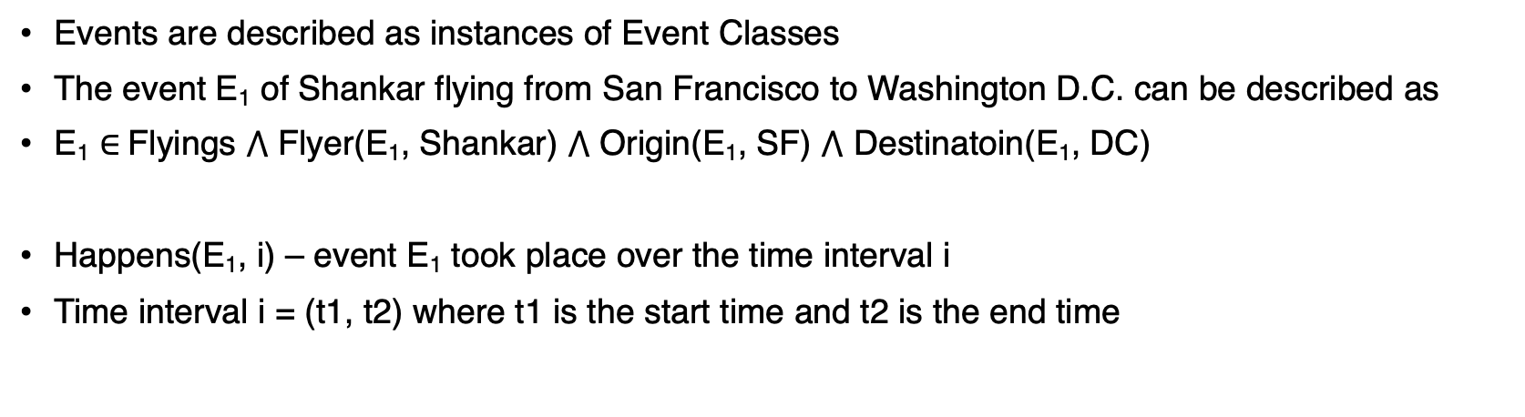
Events
Events are described as instances of Event Classes
The event E₁ of Shankar flying from San Francisco to Washington D.C. can be described as
E₁ $∈$Flyings $⋀$ Flyer(E₁, Shankar) $⋀$ Origin(E₁, SF) $⋀$ Destinatoin(E₁, DC)
Happens(E₁, i) – event E₁ took place over the time interval i
Time interval i = (t1, t2) where t1 is the start time and t2 is the end time

Slide 18
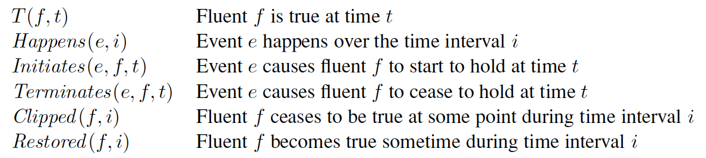
Events
The complete set of predicates for one version of event calculus is

Slide 19
Processes
Discrete Events – have a definite structure
Shankar’s trip would have a beginning, middle and end
If interrupted halfway, it would be something different
If we take a small interval of Shankar’s flight, say, 10 minute segment, that event would still be a member of Flyings
Processes: Classes of events with this property are called process classes or liquid event classes

Slide 20

Processes
Any process e that happens over an interval also happens over any subinterval
Distinction between liquid vs non-liquid events is analogous to stuff vs objects

Slide 21
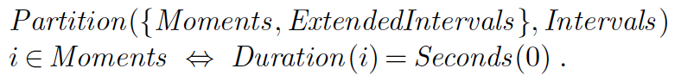
Time Intervals
Event calculus opens us to the possibility of talking about time and time intervals
Two kind of time intervals: moments and extended intervals
Moments have zero duration

Slide 22
Time Intervals
Time scale: define a time scale and associate points on the scale with moments
It is arbitrary; can be measured as seconds starting from Jan 1st, 1900
Functions Begin and End - earliest and latest moments in an interval
Function Time – delivers point on the time scale for a moment
Duration – gives the difference between end time and start time

Slide 23
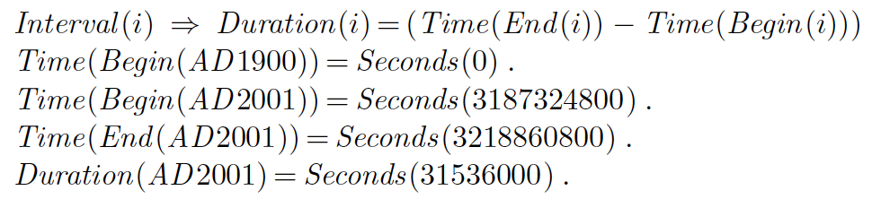
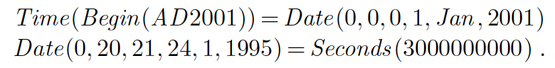
Time Intervals
A function Date – takes time arguments like hour, minutes, etc., and returns a time point

Slide 24
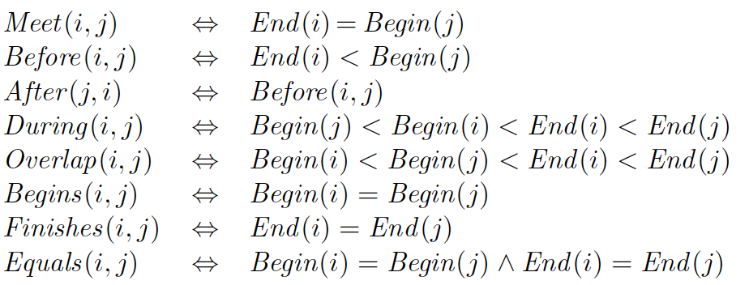
Time Intervals
Meet – two intervals meet if the end time of first equals start time of second
The complete set of interval relations

Slide 25
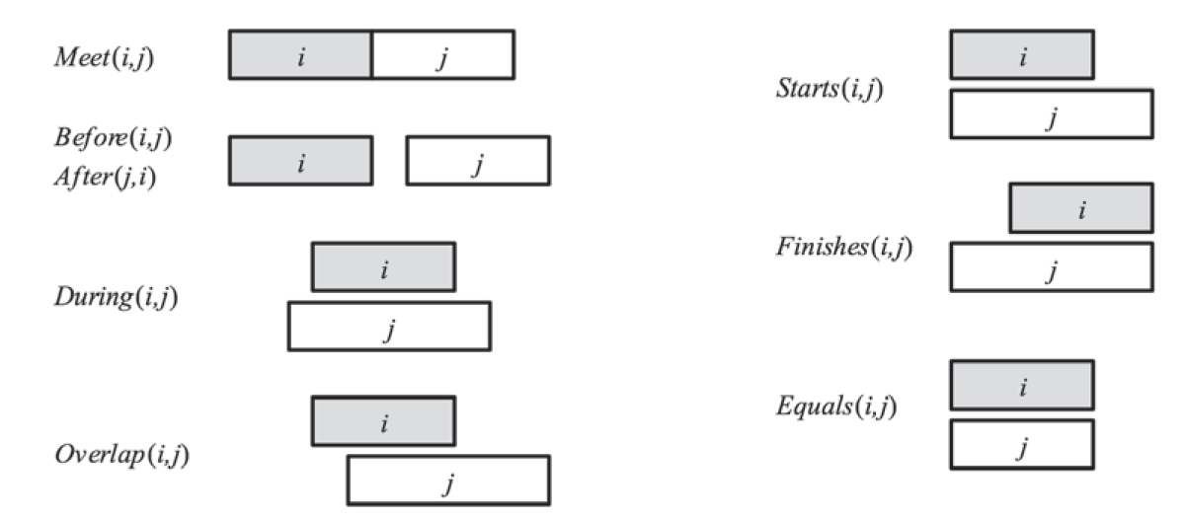
Time Intervals

Slide 26
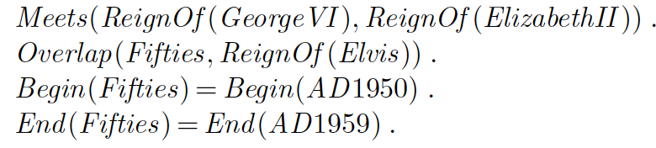
Time Intervals
To say the reign of Elizabeth II immediately followed that of George VI
The reign of Elvis overlapped with the 1950s, we can write
Overlap(i, j) only holds if i begins before j

Slide 27
Mental Events and Mental Objects
Agents constructed so far have beliefs
However, we haven’t yet understood what knowledge do we have about these beliefs.
Knowledge about one’s own knowledge and reasoning process is useful for controlling inference
E.g., Alice asks Bob – “What is the square root of 1764”
Bob says - “I don’t know”
If Alice insists – “Think harder!”
Bob should realize that with some more thought it can be answered
E.g., Alice asks Bob – “Is your mother sitting down right now?”
then Bob should realize that thinking harder doesn’t help rather just ask his mother

Slide 28
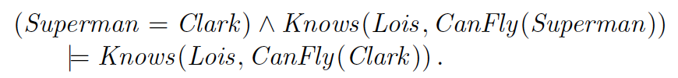
Mental Events and Mental Objects
We need a model of mental objects (KB) and of mental processes that manipulate those objects
Propositional Attitudes: Believes, Knows, Wants, Intends, and Informs
They do not behave like normal predicates
E.g., Lois knows that Superman can Fly
Knows(Lois, CanFly(Superman))
If it is true that Superman is Clark Kent, then we must conclude that Lois knows that Clark can fly
A consequence of equality reasoning built into Logic

Slide 29
Modal Logic
Regular Logic is concerned with single modality, i.e., ”P is true”
Modal Logic include modal operators that take sentences as arguments
E.g., A knows P is represented as K_{A} P, where K is the modal operator for Knows
Takes two arguments, an agent and a sentence
Syntax of modal logic is same as FOL

Slide 30
Thank You!
In our next session:
Forward and Backward Chaining

